Slide 1
(IMDCGD214-16YRD) Level 4/5 Group 15
Elliot Page Ben Reynolds Roberto Mitrea

Slide 2
Brief
For 2 players
Physics based
Adversarial
(i.e. “...characterised by conflict or opposition” – Oxford Dictionary)
On a single device
(i.e. No hidden information)

Slide 3
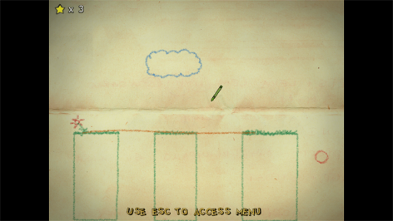
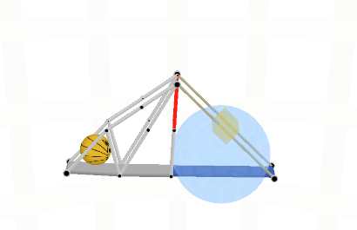
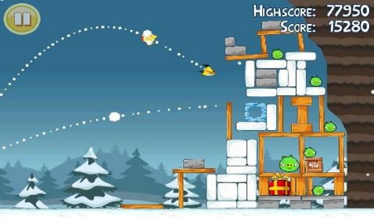
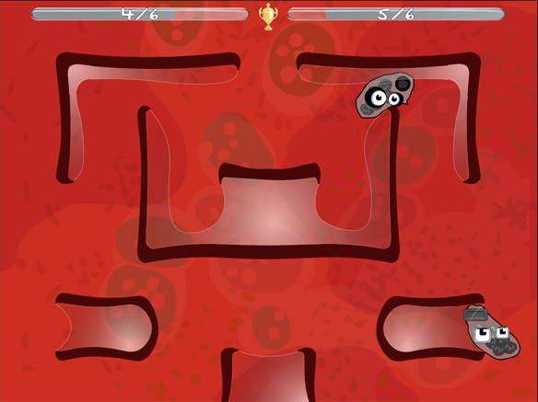
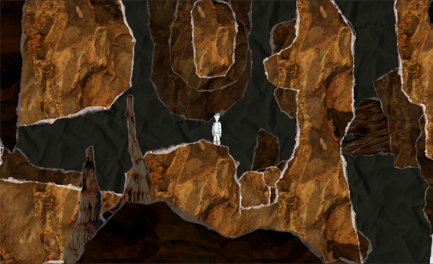
Research

Slide 4
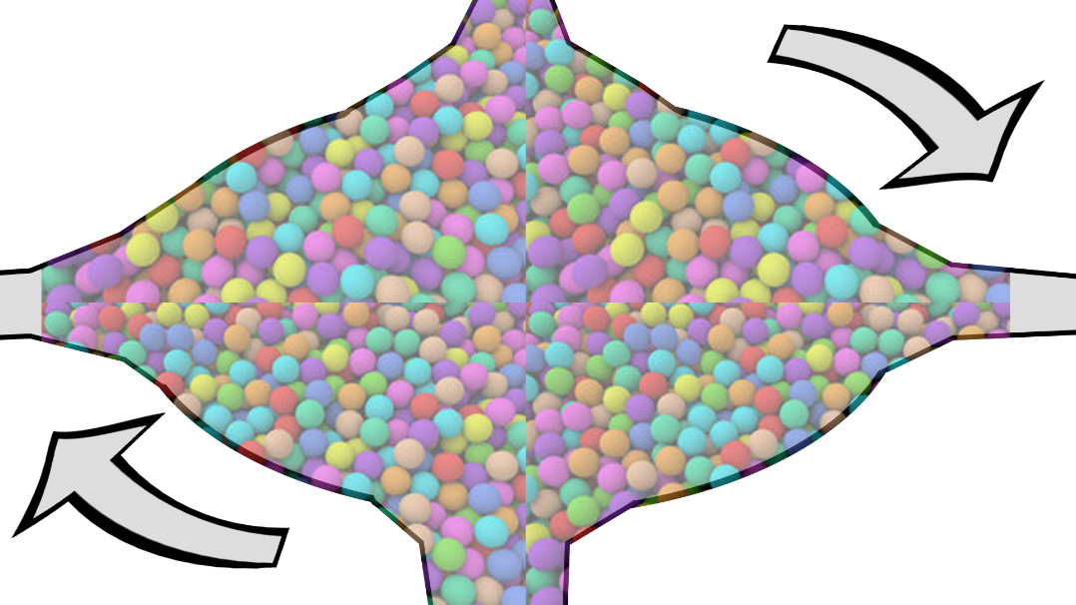
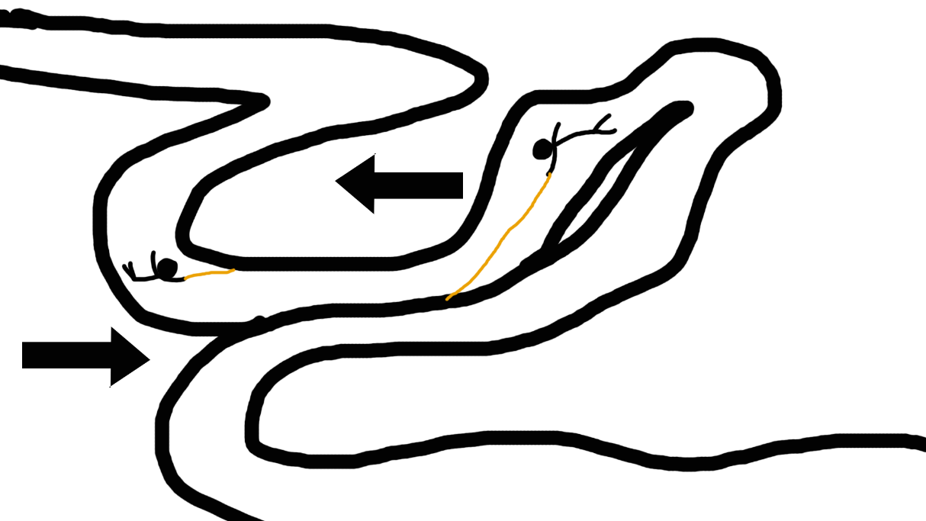
Discarded Prototypes

Slide 5
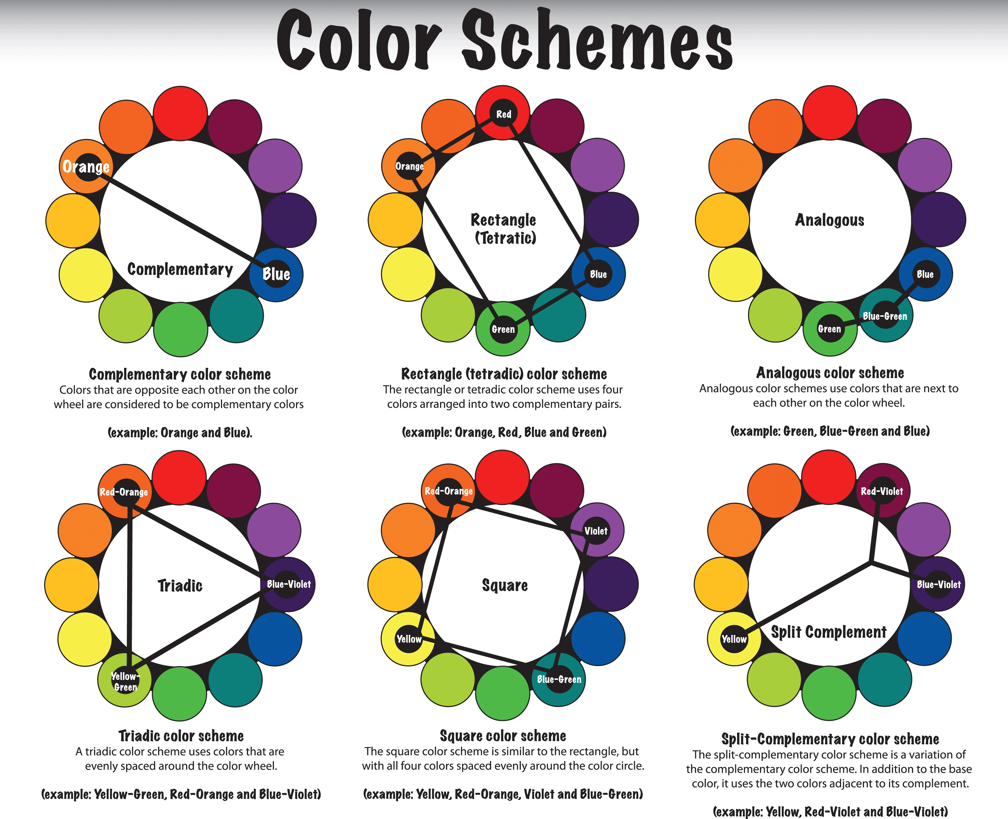

Research
Demographic: Males, 18-24

Slide 6




Research

Slide 7
Our Game

Slide 8
Core Mechanic
Twitch Movement
Aiming the grapple hook
Navigating the environment

Slide 9
What The Player Does
Controls
Axis Movement
Gameplay
Destroy items to increase score
Player with the highest score at the end of the round wins

Slide 10
Prototype

Slide 11
Next Steps
Add sounds
More playtesting
More polishing

Slide 12
Feedback/Questions?

